Slide 1
What time is it?
:(

Slide 2
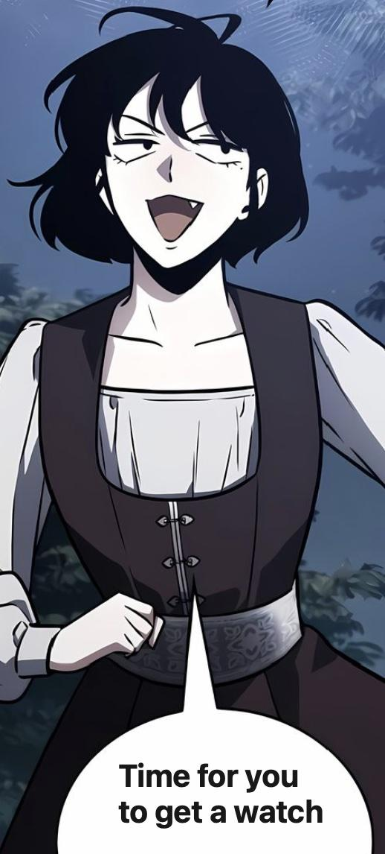

Slide 3

bruh…

